Slide 1

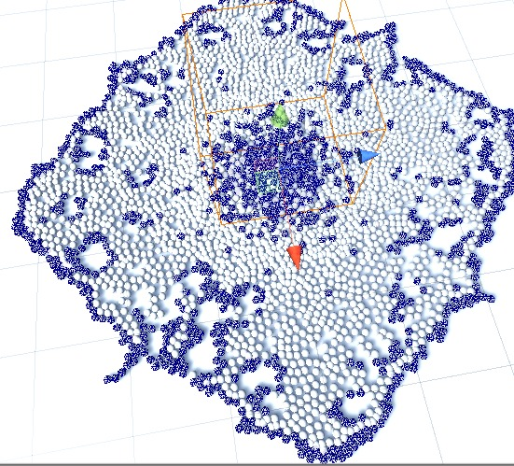
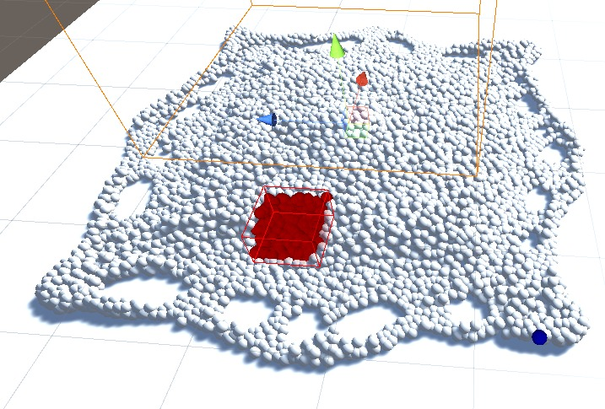
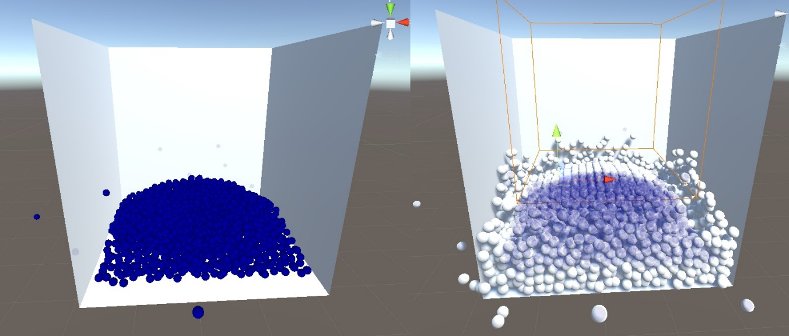
Performance Optimized Fluids
Baran Budak, Cihanser Çalışkan, İsmail Mekan -- Supervisor: Mehmet Ufuk Çağlayan
Aim
The POF project aim is researching smoothed particle hydrodynamics and enhancing the performance of the particle-based fluid simulation. Increasing the efficiency and performance of an existing particle-based fluid simulation is a major goal. We aim to achieve these goals by implementing a variety of algorithms to the POF system such as using special structures to detect and store particles.
Implementation
We described the implementation as three main titles: First implementation Hasher benefits to the POF by accessing particles easier. The second implementation is surface recognition which is an algorithm used from Akıncı, G. et al. (2012) [1] to draw vertices of surface particles. The third implementation is written by Zhu, Y. et al. [7], offers an alternative way to simulate liquids. HASHING Hashing is a technique to mapping particles in a 3-dimensional space converted as a 1D hash table that allows very fast access on particles in the 3-dimensional space domain. Hashing is used for finding particles more easily. SURFACE PARTICLES This algorithm detects surface particles and the particle's cells. We can discard cells that are not used and focus on the surface particles. The POF system works more efficiently and better performance obtained. ZHU AND BRIDSON The research paper is written by Zhu, Y. et al. [7] offers an alternative to simulate liquids. The paper mentions surface reconstruction from particles. It calculates a scalar value of vertices that outside of the fluid to send marching cubes to visualize.
Evaluation
A fluid simulation system having a difficulty to simulate too many particles. Our POF system increases the performance and simulation can handle more particles. POF system affects memory efficiency so that simulation requires less memory. The spatial hash algorithm has a huge benefit in memory efficiency. POF system makes higher frame rates possible. Surface particle recognition eliminates the cells that are not made a calculation. Surface particle cells increase the performance by discarding inactive cells. Performance and efficiency are important elements of particle-based fluid simulation.
Conclusion
The surplus of particles in a simulation can be a computational hardship for the computer. We implement various methods to get better results by doing research. POF project concentrates on solving computational difficulty problems by increasing performance and efficiency. POF makes easier to simulate with higher quantities of particles or getting better results with the same number of particles by using the hash algorithm and surface particle recognition algorithm.
Objectives
The main objective of this project is making research and implement this research results on particle-based fluid simulations. The implementation consists of three main parts in the POF system: fast quick access to data (hash), surface recognition. In conclusion, the objective of the POF project is making research and implement more beneficial ways of surface reconstruction on particle-based fluid simulations.
References
1-) [AIA12] Akinci, G., Ihmsen, M., Akinci, N. and Teschner, M. (2012). Parallel Surface Reconstruction for Particle‐Based Fluids. Computer Graphics Forum, 31, 1797-1809. 2-) [BP94] Paul Bourke 1994, Marching Cubes, viewed 1 December 2019, http://paulbourke.net/geometry/polygonise/ 3-) [MCG03] M. Müller, D. Charypar, and M. Gross (2003). Particle-based fluid simulation for interactive applications. In Proceedings of the 2003 ACM SIGGRAPH/Eurographics Symposium on Computer Animation (SCA ’03), 154–159. 4-) [PTB03] Premžoe, S. , Tasdizen, T. , Bigler, J. , Lefohn, A. and Whitaker, R. T. (2003). Particle‐Based Simulation of Fluids. Computer Graphics Forum, 22, 401-410. 5-) [TH03] Teschner, M., Heidelberger, B., Müller, M., Pomerantes, D., and Gross, M.H. (2003). Optimized Spatial Hashing for Collision Detection of Deformable Objects. VMV. 6-) [WH87] Lorensen, William & Cline, Harvey. (1987). Marching Cubes: A High Resolution 3D Surface Construction Algorithm. ACM SIGGRAPH Computer Graphics. 21. 163-. 10.1145/37401.37422. 7-) ZB05] Zhu, Y., & Bridson, R. (2005). Animating sand as a fluid. (New York, NY, USA, 2005) ACM Trans. Graph., 24, 965-972.

